Slide 1
Wine Quality Data Set
Presented by : Ratnam Dubey

Slide 2
Introduction
Wine which was once viewed as a luxury product is increasingly enjoyed by a wider variety of customers today.
Portugal is the 11th largest wine producer in the world and the 9th largest wine exporter in the world despite having a total area of only 92.212 km2
Wine certification and assessment are essential elements in the wine industry in Portugal that prevent adulteration and are important for quality assurance
Wine certification includes physiochemical tests like determination of density, pH, alcohol quantity, fixed and volatile acidity etc. We have a large datasets having the physiochemical tests results and quality on the scale of 1 to 10 of wines of the Vinho Verde variety
I am presenting a case study for modeling taste preferences based on the analytical dataset that we have from physiochemical tests of Vinho Verde wines Such a model can be used not only by the certification bodies but also by the wine producers to improve quality based on the physiochemical properties and by the consumers to predict the quality of wines

Slide 3
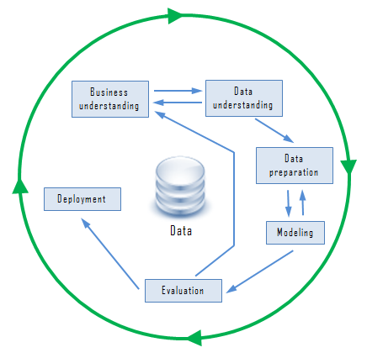
CRISP DM Process
I will use the CRISP-DM(Cross-Industry Standard Practice for Data Mining) methodology for approaching my project.
CRISP-DM is an industry standard process for data mining and it was developed by analysts representing Daimler-Chrysler, SPSS (Statistical Package for the Social Sciences).
CRISP-DM states that the life cycle of a data mining project usually consists of six phases which are iterative in nature

Slide 4
Business Understanding: This phase involves clearly defining the project objectives and goals, and translating these goals into a problem statement
Data Understanding: This phase involves collection of data and performing a preliminary analysis on the data to evaluate the data quality. Data understanding phase may also contain making subsets of data that may have any actionable patterns.
Data Preparation: This phase is the most time taking one in the data mining process. It involves cleaning the data, performing certain transformations on the data to get the final dataset
Modeling: This phase involves selecting the appropriate modeling technique
Deployment: In this phase the effective models are finally use. It may be making a simple report or using the insights in the daily functioning of a company
Evaluation: The models generated during the modeling phase are evaluated for quality and also its determined whether the business objective is which means whether the problem statement is solved or not

Slide 5
Profound Question: Can we predict the quality of wine by applying a data mining
model on the analytical dataset that we have from physiochemical tests of Vinho
Verde wines?
Goal: The goal of this project is to derive rules to predict the quality of wines
based on data mining algorithms.
Application: The predictions from this model can be used by manufacturers to
improve the quality of wines, certification agencies for better understanding of
aspects important for quality and lastly by customers to be make informed
decisions while buying wines.

Slide 6
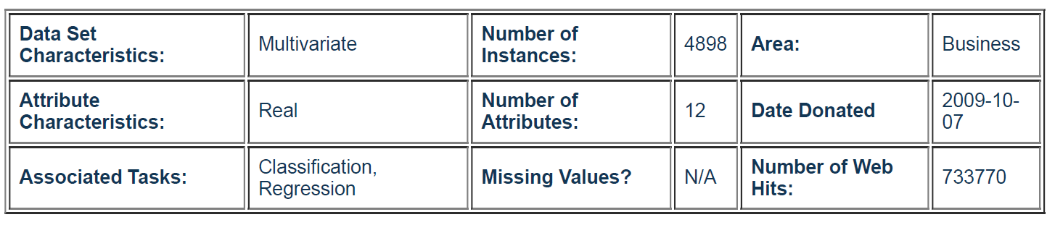
Data Understanding
This dataset is related to the white wine variants of the Portuguese Vinho Verde variety of
wine. Due to privacy and logistics issues the dataset only contains physiochemical(input)
and sensory(output) variables
Data source: https://archive.ics.uci.edu/ml/datasets/Wine+Quality

Slide 7
Data Understanding
Attribute | Description
fixed acidity | Acidity is a fundamental property of wine, imparting sourness and resistance to microbial infection. Fixed acidity is the no. of grams of tartaric acid per dm3
volatile acidity | Wine spoilage is legally defined by volatile acidity which is calculated as no. of grams of acetic acid per dm3 of wine
citric acid | It is the no. of grams of citric acid per dm3 of wine
residual sugar | Residual sugar refers to the sugar remaining after fermentation stops. Given as no. of grams per dm3
chlorides | It is the no. of grams of sodium chloride per dm3 of wine
free sulfur dioxide | It is the no. of grams of free sulfites per dm3 of wine
total sulfur dioxide | It is the no. of grams of total sulfite (free sulfite+ bound sulfite) in per dm3 of wine
density | It gives the density of the wine in grams per cm3
pH | It gives the pH of the wines. pH is used to measure ripeness in relation to acidity
sulphates | It gives the no. of grams of potassium sulphate per dm3 of wine
alcohol | It gives the volume of alcohol in percentage
quality | This is the target variable. Here the wine is rated from 1-10 based on the quality

Slide 8
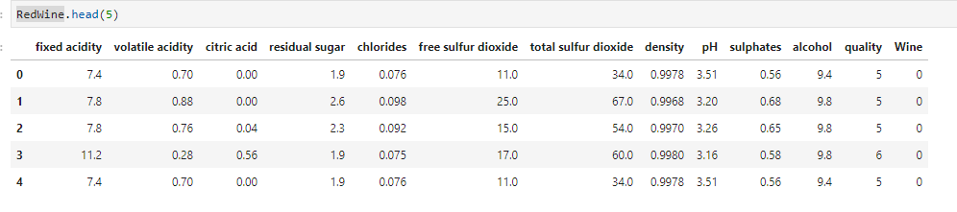
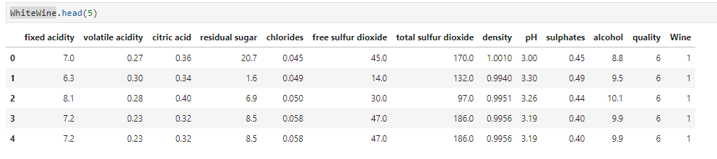
Data : Red & White

Slide 9
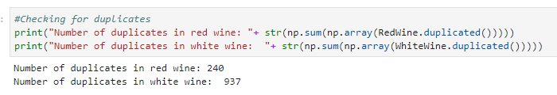
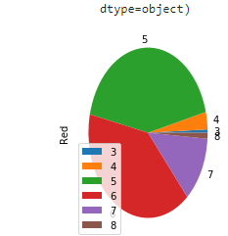
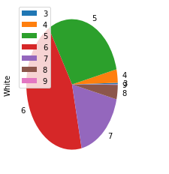
Duplicate ?
The red wine data has 240 duplicated rows whereas white wine has 937. While duplicated rows may cause biases in analysis and inference, I think the duplicated rows here look more like several wine tasters rating the same wine similarly. Hence, it will be relevant to keep all the observations as this can add more information.
Red & White wine Quality Distribution

Slide 10
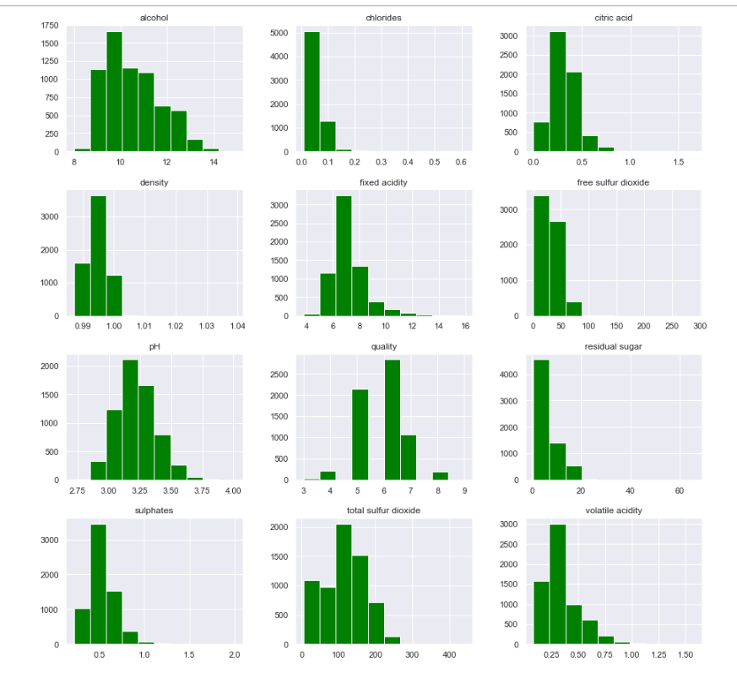
EDA – Exploratory Data Analysis
Free sulfur dioxide from 0 to 120; total sulfur dioxide from 0 to 300.
Volatile acidity from 0 to 1.1; sulphates from 0.2 to 1.3; chlorides from 0 to 0.4.
Wine quality rating are discrete ranging from 3 to 9, with large proportion in the category 5, 6 & 7.
The scale of the features are quite different. Hence, using algorithms that are based on distance, e.g. kNN, may focus unfairly on these features. To use such classifiers, the data would have to be normalized.

Slide 11
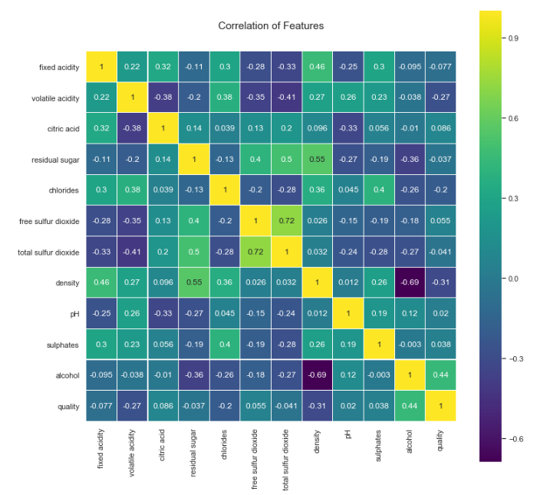
Correlation Matrix
One thing that the correlation plot tells us is that there are very few features strongly correlated with one another. From the point of view of feeding these features into our ML models, this means that there isn't much redundant data as each feature carries with it some unique information.
From the plot, the two most correlated features free sulfur dioxide and total sulfur dioxide. Another point is that alcohol correlates most with quality than any of the other features at 0.44.

Slide 12
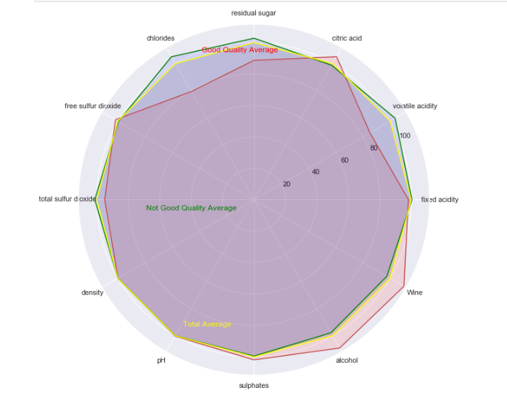
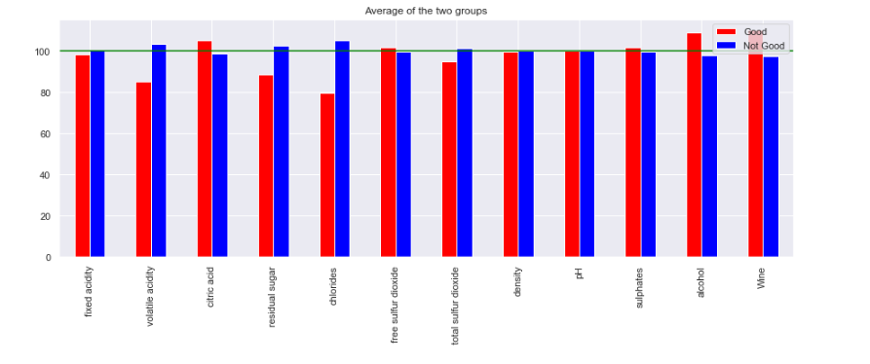
Radar Plot
A radar chart is a graphical method of displaying multivariate data in the form of a two-dimensional chart of three or more quantitative variables represented on axes starting from the same point. The relative position and angle of the axes is typically uninformative - Wikipedia

Slide 13


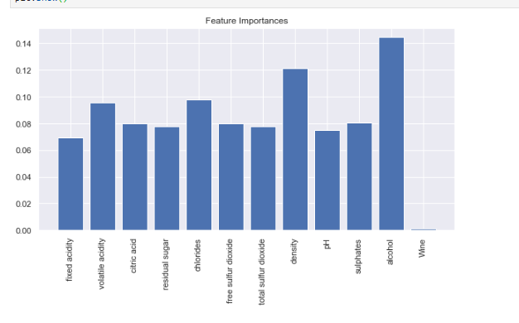
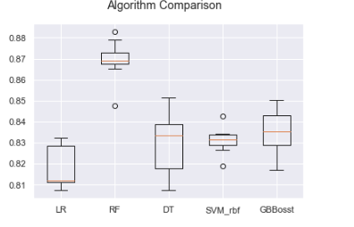
Modelling Prediction
Random Forest Classifier has the highest training & test accuracy of about 87% , followed by Decision Trees with training & test accuracy of about 81% & 86% accuracy.
Let's create a plot of the model evaluation results and compare the spread and the mean accuracy of each model. This is a population of accuracy measures for each algorithm as each algorithm was evaluated 5 times (5-fold cross validation).

Slide 14
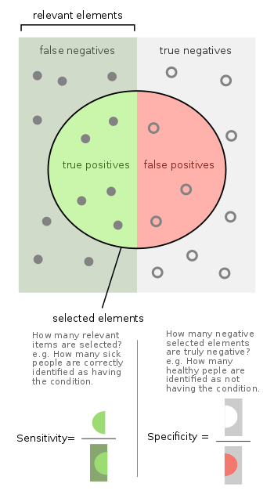
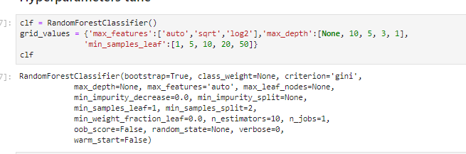
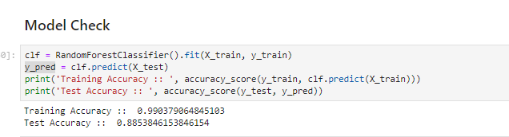
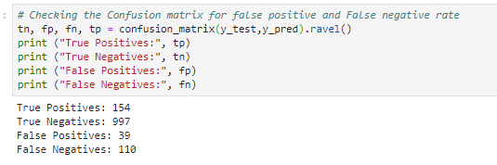
Feature Tuning

Slide 15
Thanks Questions ??

